Slide 1





Home
About Us
Contact
Page 001
Thynk Unlimited
E-learning Student Analysis
Petchiyammal R
Data Analyst Intern

Slide 2

Thynk Unlimited
Home
About Us
Contact
Page 002
Dropouts and low engagement are the biggest challenges in e-learning.
The project focuses on analyzing student engagement, performance, and dropout trends.
Introduction &
Objects
Analyze student engagement patterns
Measure how engagement impacts performance
Identify dropout risks & recommend improvements

Slide 3

Thynk Unlimited
Home
About Us
Contact
Page 003
Data
& Preparation
Dataset: 800 students, 8+ variables (Logins, Time Spent, Quizzes, Assignments, Final Score, Completion Status).
Data Cleaning: removed duplicates, fixed column formats.
Data Transformation: Created Engagement ScoreGrouped Logins, Quizzes, Time Spent, Assignments into ranges

Slide 4

Thynk Unlimited
Home
About Us
Contact
Page 004
Engagement Dashboard
Most students are in the medium engagement range
High engagement → more logins, more study hours, higher completion rate
Low engagement → fewer logins, less study time, higher dropout risk
Engagement score shows a direct link with performance
Consistent weekly activity improves learning outcomes

Slide 5
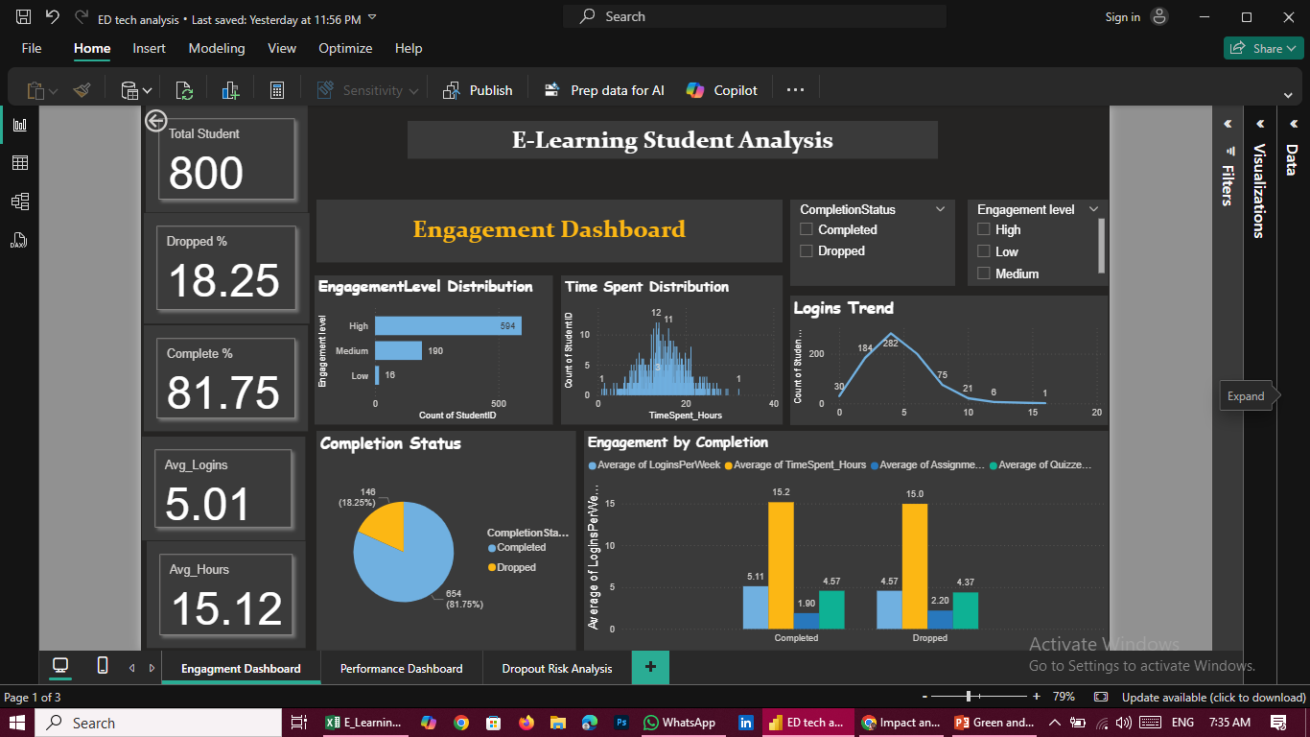

Slide 6


Thynk Unlimited
Home
About Us
Contact
Page 006
Performance Dashboard
Positive correlation: Time Spent ↑ → Final Score ↑
Students with >5 quizzes scored ~20% higher
Assignments major factor in completion
Forum participation linked to stronger performance

Slide 7
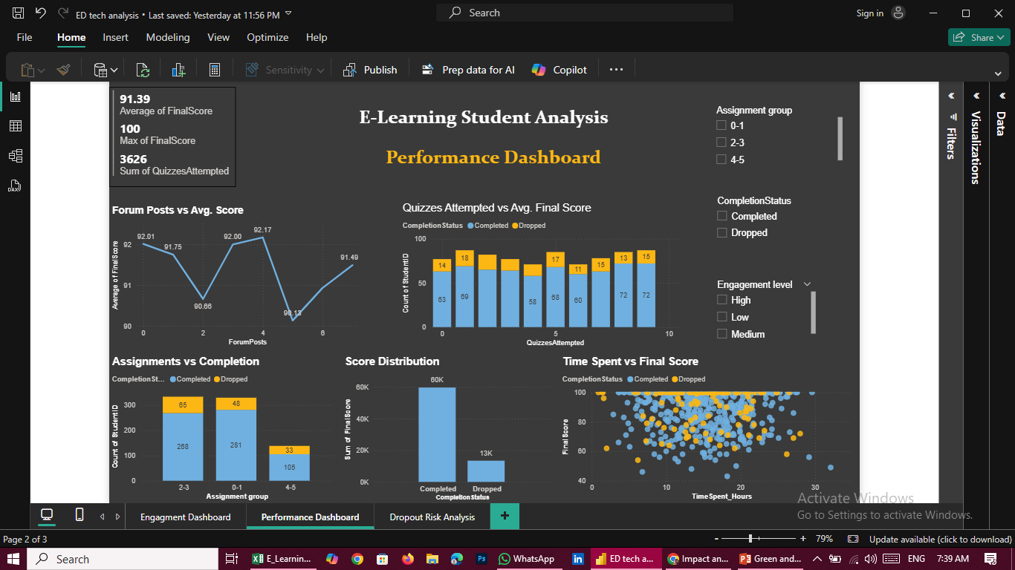

Slide 8

Thynk Unlimited
Home
About Us
Contact
Page 006
Dropout
Dashboard
Dropout rate ~18%
Dropouts = low logins, low study time, few assignments
Funnel shows major drop from Logins → Quizzes → Assignments
Early alerts can reduce dropout significantly

Slide 9
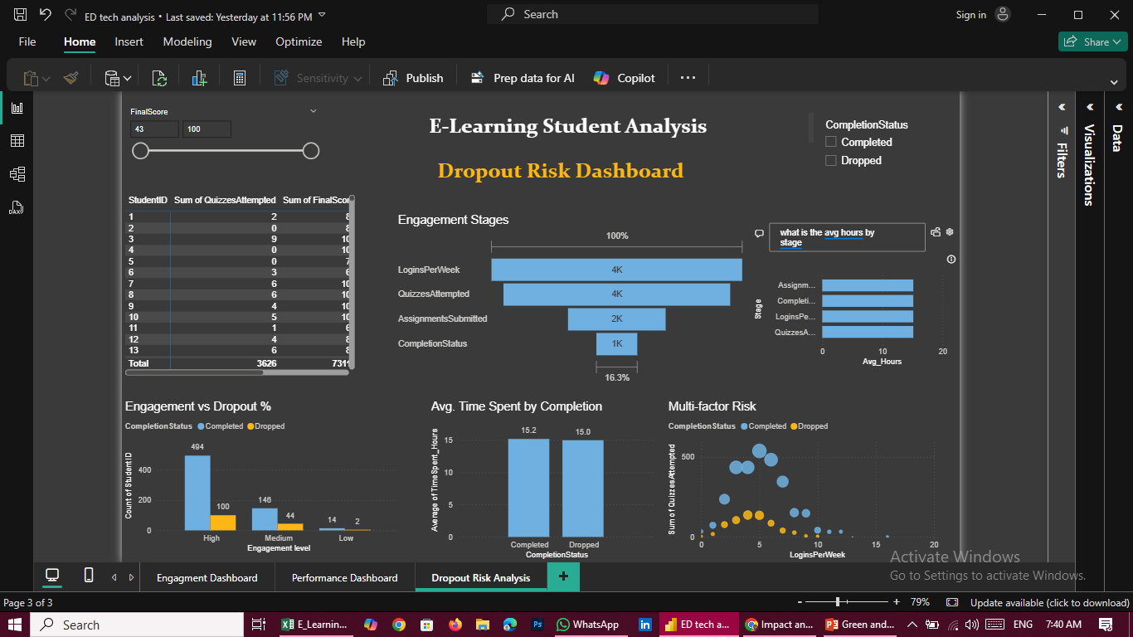

Slide 10
Thynk Unlimited
Home
About Us
Contact
Page 007
Key Findings
Engagement level strongly predicts success
Quizzes & Assignments drive better performance
Dropouts show early signs of disengagement
Recommendations
Encourage weekly logins with reminders/rewards
Provide early alerts for low-engagement students
Increase practice quizzes & assignment deadlines
Promote forums for peer learning

Slide 11


Home
About Us
Contact
Page 011
Thynk Unlimited
Thank
You!
Thank you for joining us in

